Slide 1
A brief overview of the Morph protocol

Slide 2
How do Morph and web services compare?
Morph architecture is based on web services
Morph capabilities go beyond web services
Morph protocol is unique

Slide 3
Capabilities of Morph
Remote Method Invocation
Objects by value and by reference
Streaming
Sessions
Security (encryption, compression, validation)
IPv4, IPv6, Bluetooth
Platform independent
Lightweight
Application level routing
etc.

Slide 4
Concepts
Message structure
Service vs. Apartment
Servlets

Slide 5
Message structure:
Chain of links
Frame types:
Envelope (Message frame)
Link (other frames)

Slide 6

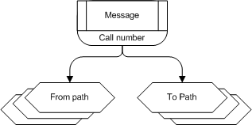
Chain of links
Call
Reply
Message link

Slide 7
Service vs. Apartment
Service is apartment factory
Apartment is logical memory space
Apartments can be shared

Slide 8
Servlets
Servlet provides apartment access to business object
Service apartments have Default servlet

Slide 9
Examples:
Setting up a service
Calling a service
Calling a servlet
Two way RMI

Slide 10
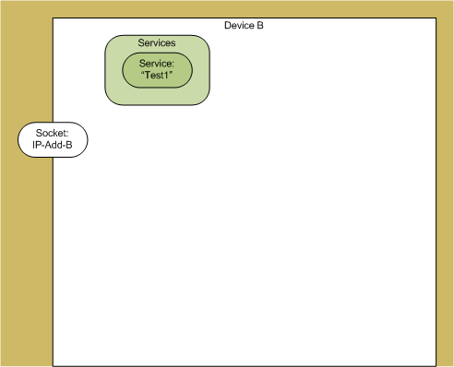
1. Setting up a service

Slide 11
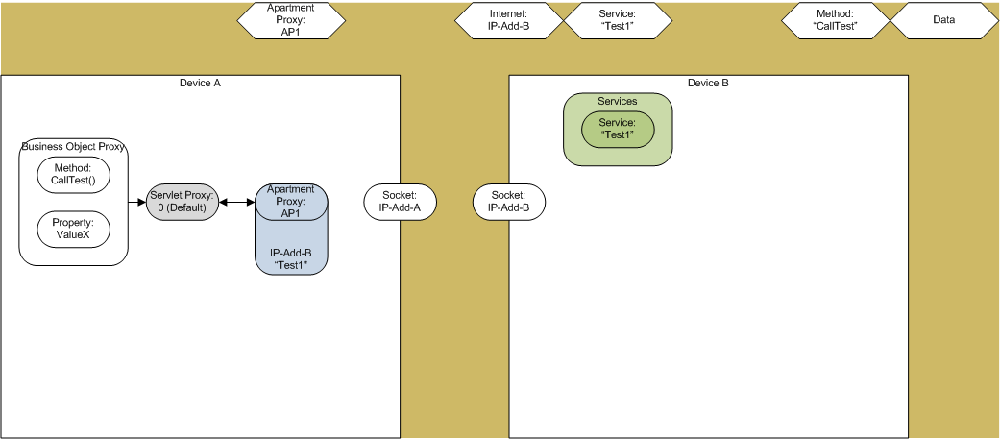
2.a. Calling a service

Slide 12
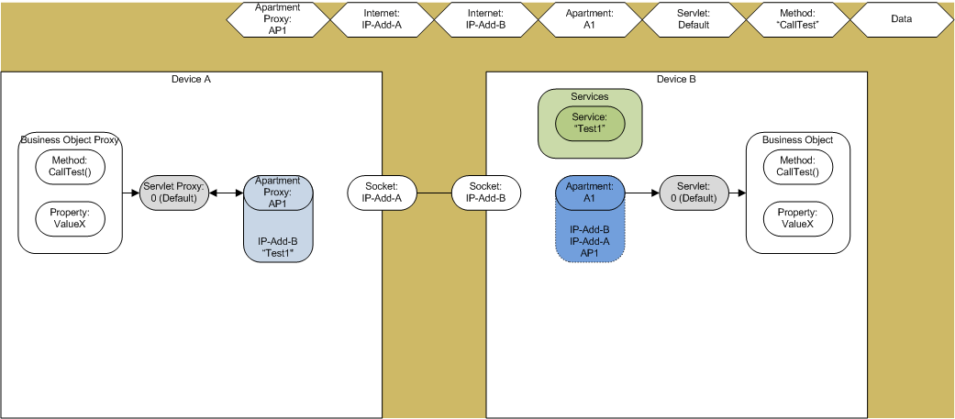
2.b. Service called

Slide 13
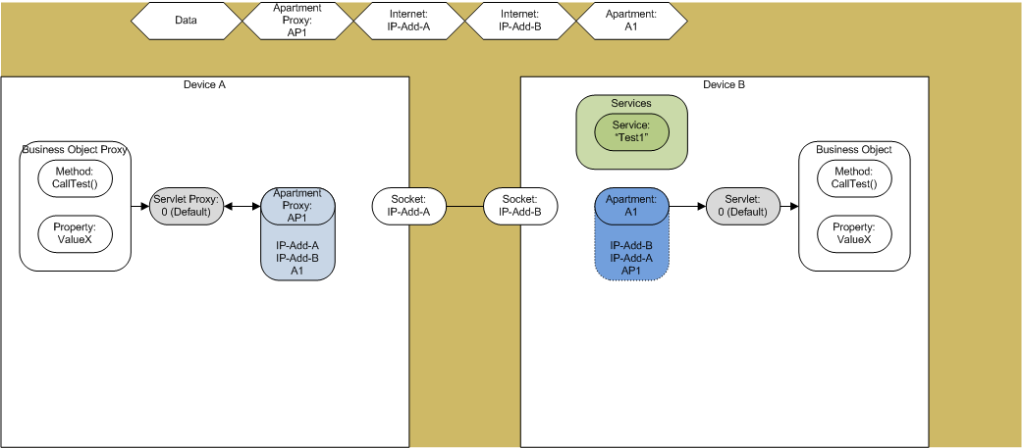
2.c. Service reply

Slide 14
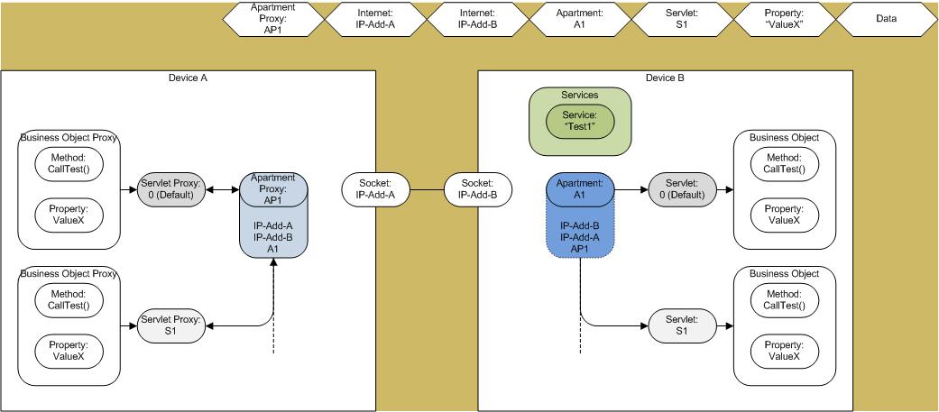
3.a. Calling a servlet

Slide 15
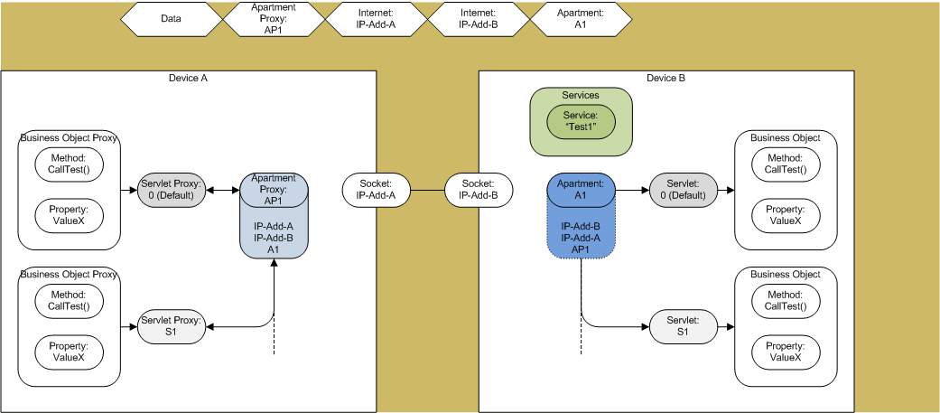
3.b. Servlet replied

Slide 16
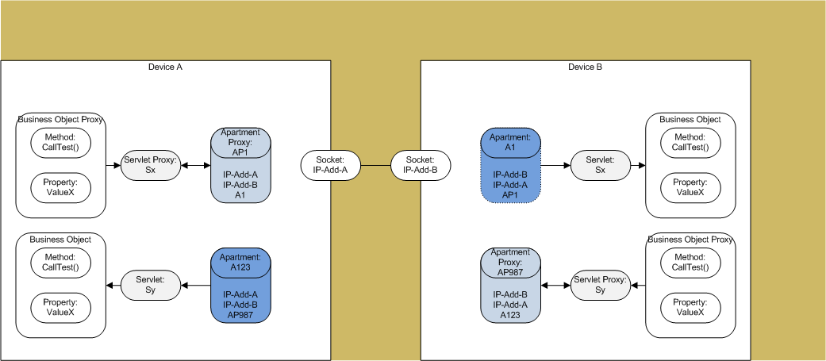
4. Two way RMI

Slide 17
Current state of Morph

Slide 18
RMI
Methods and properties
Synchronous and asynchronous calls

Slide 19
Parameter types
Objects by value
Objects by reference
Streams by reference
Some base types
Arrays and/or Structs of all the above

Slide 20
Exceptions
Remote application exceptions
Morph errors

Slide 21
Links
End
Message
Data
Internet
Bluetooth
Service
Servlet
Exception
Method/Property
Stream
Encoding
Batch
Sequence
Information

Slide 22
Platforms
C#
Java
Objective C
Others…

Slide 23
Future plans
Is it useful to others?
Moving ahead
Open source
Public domain
Commercial
Other…?

